Slide 1
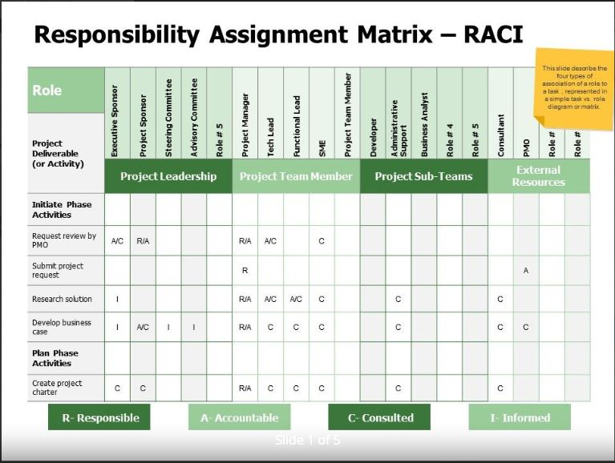
RASCI (Responsible / Accountable / Support / Consulted / Informed) Chart
Problem
How to represent task roles?
Difficulty
Easy to use
RASCI is a tool to determine Roles and Responsibilities for tasks.
Using RASCI every person in a task has a well-defined role.
The “Accountable” person is key!
  Every activity/task has only one “A”
  From the outside, the “A” person is the single point of contact for a specific task.
Responsibility assignment matrix
Clear ownership of each task
RASCI
Chart
process
Collection of tasks
Identify all activities/tasks (these are rows)
Identify all the roles/players (these are columns)
Identify who has R, A, S, C, I for each activity/task
Resolve gaps/overlaps with the team
Copyright © 2022-2025-2024 Dan Zwillinger. All rights reserved.
https://commons.wikimedia.org/wiki/File:RACI_MATRIX_PPT_TEMPLATE.jpg

Slide 2
RASCI – Example – Creating a 6in6 presentation
Notes
To create a new 6in6 presentation, several subtasks need to be performed (read bottom-up).
A single person may have multiple roles.
There is only one “A” in each task/row (the single accountable person)
There is at least one “R” for each task/row (the responsible person/people)
Color coding the {R,A,S,C,I} can make a RASCI chart easier to review.
From the RASCI chart, we can infer that
  Dan is in charge
  Alice owns the research activities
  Cathy owns the internet activities
  David owns the editorial activities
  Frank is a resource used by many
Everyone knows what their role is for each part of the 6in6 presentation creation process.
Copyright © 2022-2025 Dan Zwillinger. All rights reserved.

Slide 3
RASCI – Notes
Slide 1
Slide 2
RASCI is a way to ensure that project members understand their role on a project.
There are many variations of the RASCI model, such as
  “RACI” where the “S” roles are not articulated.
  “RACIQ” which includes a Q=Quality Review role
  “PACSI” where the P=Performer role is the same as the R role
This example is for creating a 6in6 presentation. There is one main task which requires several sequential sub-tasks.
  Each sub-task has an owner (the “A”) and at least one person responsible (the “R”) for getting the needed work done.
From the tasks assigned, we can infer roles. For example, Cathy is the “R” for uploading the 6in6 presentation – she may own all internet activities.
Counting the number of times a person has an activities can indicate how busy they are.
  Counting the number of different activities can indicate their versatility.
Recommended web sites for additional information
https://www.whatissixsigma.net/raci-matrix/
https://project-management.com/understanding-responsibility-assignment-matrix-raci-matrix/
Copyright © 2022-2025 Dan Zwillinger. All rights reserved.

