Slide 1
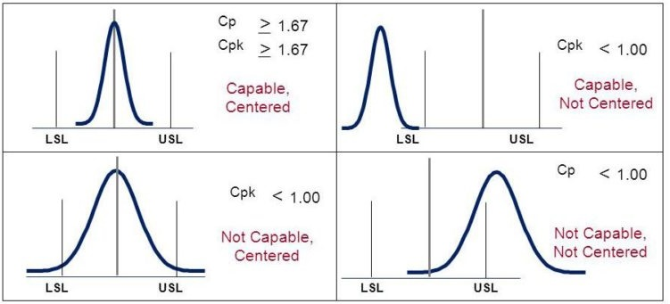
Process Capability metrics (Cp and Cpk)
Problem
How to statistically assess a process?
Difficulty
Work with an SME
Process capability is a statistical assessment of whether or not a process is capable and/or centered. You want both.
Consider a car entering a garage:
  capable (Cp>1) means the car usually arrives at the same location,
  centered (Cpk>1) means the car enters the center of the garage.
Existing process
Statistical Process Analysis
Process assessment
Obtain customer specs (USL & LSL)
Determine the process’ sample mean (m) and standard deviation (s)
Compute the Cp and Cpk metrics
Interpret the metrics
Formulae
Cp = (USL – LSL) / (6*s)
Cpk = minimum( (USL–m)/(3*s), (m–LSL)/(3*s) )
Cp = Process Capability = the number of times the spread of the process fits into the tolerance width. Larger values are better.
Cpk = Process Capability corrected for position. Larger values are better.
USL & LSL – Customer’s Upper & Lower Specification Limits
m = process mean
s = process standard deviation
https://www.latestquality.com/how-to-calculate-cp-and-cpk/
Copyright © 2022 Dan Zwillinger. All rights reserved.

Slide 2
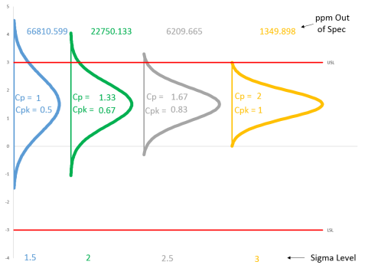
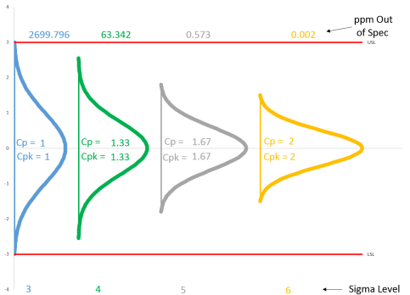
Process Capability metrics – Example
Consider the following case
m = average = 0
s = standard deviation = as specified below
LSL = Lower Specification Limit = – 3
USL = Upper Specification Limit = 3
Deceasing variance ➔ fewer parts out of spec
Change the example to have
m = average = 1.5
Note: a capable process (Cp > 1.0) does not ensure that a product is within specifications.
Interpretation: if s=3/4 then, at a 4 sigma level, Cp=CPK=1.33, and 63 parts per million (ppm) will be out of spec
Interpretation: if s=3/4 then, at a 2 sigma level, Cp=1.33, CPK=0.67, and 22,750 parts per million (ppm) will be out of spec
s=1
s=3/4
s=3/5
s=1/2
s=1
s=3/4
s=3/5
s=1/2
Specified six sigma level
https://www.spcforexcel.com/knowledge/process-capability/interactive-look-process-capability
Copyright © 2022 Dan Zwillinger. All rights reserved.

Slide 3
Process Capability – Notes
Slide 1
Slide 2
The process standard deviation should be obtained from a range chart.
The formulae are straightforward to compute and to interpret.
On the figures, “ppm” = parts per million
As the process variance decreases the performance improves (i.e., more results are within the customer specification, which is the same as reduced defects)
However, if the process is not centered, then there may still be a large number of defects, even with a small variance.
Copyright © 2022 Dan Zwillinger. All rights reserved.

