Slide 1
Hidden Factory
Difficulty
Problem
How to identify waste due to unnecessary work?
Some training required
A Hidden Factory is created when a defect flows downstream.
The hidden factory represents process activities causing loss of: Availability, Efficiency, Schedule, Quality, or Performance.
Visualization tools can help identify wastes caused by the “hidden factory.”
Existing process
Hidden Factory
Identification of wastes
Assemble team
Scope the mapping effort
Choose an appropriate visualization tool, such as
  Spaghetti diagram
  Time value map
  Process map
  Swim lane diagram
  Turtle diagram
  …
Map the process
Identify waste (and then remove it)
Copyright © 2022-2023 Dan Zwillinger. All rights reserved.

Slide 2
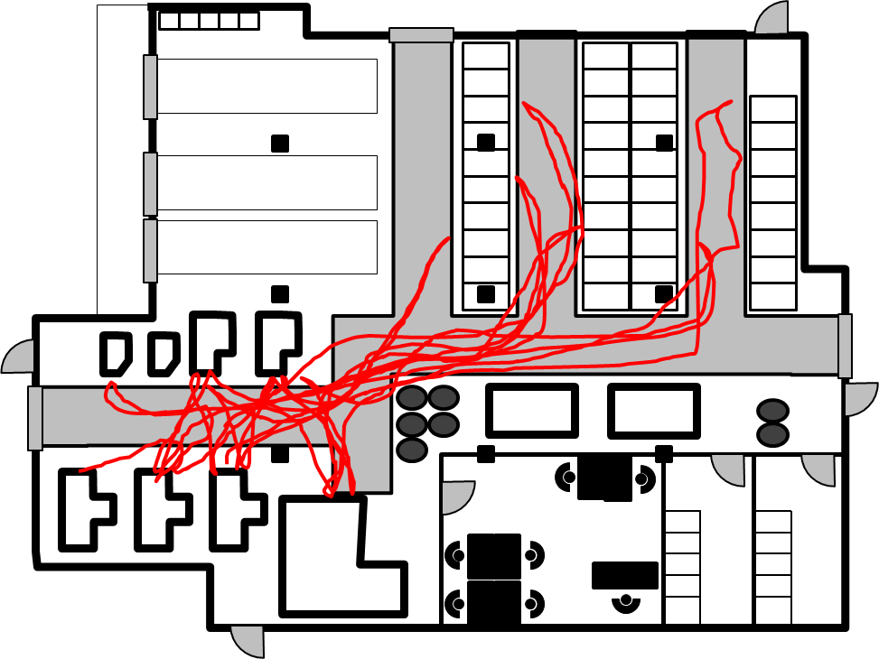
Hidden Factory – Example Mapping Techniques
Time value map
Shows non-value added activities with durations
Turtle diagram
Shows key activities
https://creazilla.com/nodes/3164991-turtle-clipart
Spaghetti diagram
Shows unnecessary motion
Swimlane diagram
Shows who does what, when, and with what input
https://www.allaboutlean.com/wp-content/uploads/2015/06/Spaghetti-Diagram.png
Copyright © 2022-2023 Dan Zwillinger. All rights reserved.

Slide 3
Hidden Factory – Notes
Slide 1
Slide 2
The 6in6 on “7 Wastes” describes the 7 classic types of wastes. Actually identifying where those wastes appear is facilitated by thinking in terms of a “hidden factory”.
Visualization tools are useful as they often quickly summarize a complicated situation.
There are many standard visualization tools.
You can create your own type of visualization to show the actual process that is occurring.
Copyright © 2022-2023 Dan Zwillinger. All rights reserved.

