Slide 1
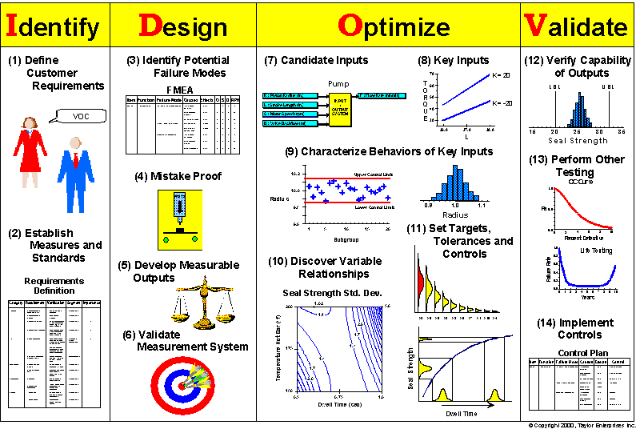
Design for Six Sigma (DFSS)
Problem
How to create a new process?
Difficulty
Work with an SME
Design for Six Sigma (DFSS) is used to create new products, processes, or services.
  And to do it right the first time.
  Traditional Six Sigma improves an existing product, process, or service.
DFSS methodologies include: DCCDI (Define, Customer Concept, Design and Implement), IDOV and DMADV (see images, below).
  Each uses multiple 6 sigma tools.
Customer need
DFSS
Process
New process
Select a DFSS methodology (e.g., IDOV)
Follow the steps of this methodology, using six sigma tools for each step.
IDOV (Identify, Design, Optimize, Validate)
DMADV (Define, Measure, Analyze, Design, Verify)
https://isowatch.wordpress.com/2018/10/23/six-sigma-is-draining-employees-creativity/
https://isowatch.wordpress.com/2018/10/23/six-sigma-is-draining-employees-creativity/
Copyright © 2022-2025 Dan Zwillinger. All rights reserved.

Slide 2
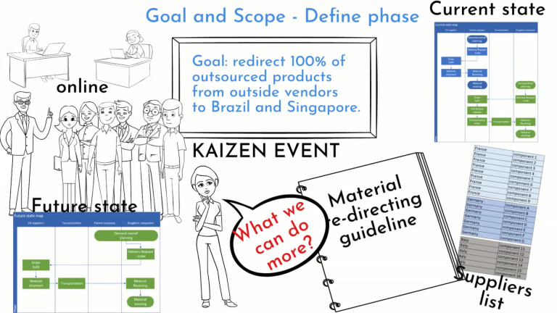

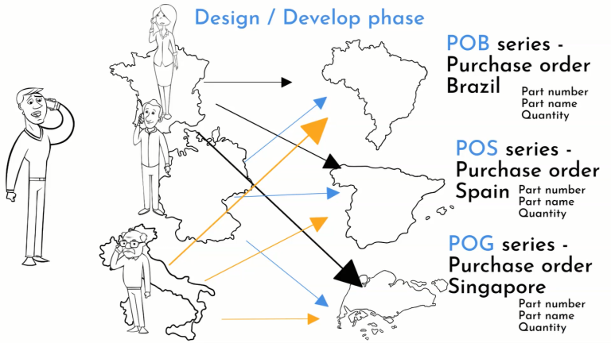
DFSS – Example – Bicycle Manufacturer
Images below are from “How to do DMADV Process? Supply Chain Easy Example” at https://sixsigmamania.com/?p=338 (with permission)
For each step, use multiple six sigma tools (some are listed below)
Step 1: Define
Select DMADV process. Then:
Define: Voice of the customer, SWOT, current state analysis, Kaizen, SIPOC
Measure: critical parameter management
Analyze: value stream map
Design: balanced scorecard, FMEA, control plan
Verify: Gage R&R
Step 5: Verify
Step 4: Design
Copyright © 2022-2025 Dan Zwillinger. All rights reserved.

Slide 3
DFSS – Notes
Slide 1
Slide 2
There are many different DFSS methodologies; most will work in most applications.
  One website lists 11 different methodologies. (https://www.scmdojo.com/design-six-sigma-methodologies/)
An SME can help select the most appropriate methodology and the most appropriate tools for each step of the methodology.
A complete DFSS example entails many tools for each step of the methodology. One way to summarize the results obtained from all the tools used at a single step is via a graphic.
This example is notational. For every DFSS activity the specific 6 sigma tools used are chosen for the specific application.
Recommended web sites for additional information
https://www.creativesafetysupply.com/articles/understanding-design-for-six-sigma-dfss/
https://www.scmdojo.com/design-six-sigma-methodologies/
Copyright © 2022-2025 Dan Zwillinger. All rights reserved.

